Slide 1

Teaching Geospatial Programming and Data Science to AgriScience Students: Analyzing Weather Network Data (WND) in Jupyter Notebook
Dharmendra Saraswat* and Gang Shao**
* Associate Professor, Agricultural and Biological Engineering Department
** Assistant Professor, Purdue Libraries and School of Information Studies
West Lafayette, Purdue University
Session: Instructional Case Studies with Data Sets for YOUR Instruction
July 14, 2021, 10 am to 12:30 pm (CDT)

Slide 2
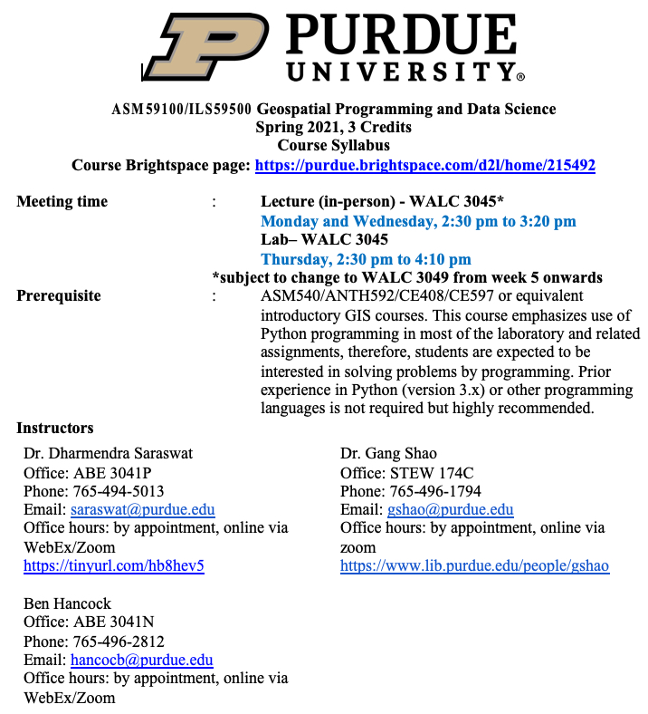
ASM591/ILS595- Geospatial Programming and Data Science
New Course

Slide 3
ASM591/ILS595- Geospatial Programming and Data Science- continue
Course aims to:
Provide fundamental Python programming concepts followed by an introduction to the Python scripting environment within ArcGIS Pro.
Students use GIS concepts to
- Perform data visualization,
- Apply advanced analytical skills using Python libraries for GIS and spatial data science,
- Automate GIS tasks
Learn to use version control with Git , and
Practice basics of sharing code using GitHub.

Slide 4
Student’s Preparedness
Two weeks of instruction and lab on Introduction to Python and Code Management
One week of instruction and lab on Data engineering.
One week of instruction and lab on creating script tools and automating ModelBuilder
One week of instruction and lab on Dataframes and workflow
Pictures
Music
Podcast
Video
Image Source: Google Cloud Platform
Image Source: Teddy Bekele, CTO, Land O’Lakes

Slide 5
6th Week Lesson Organization
Lesson purpose: Fill the missing temperature data in WHIN weather dataset using two interpolation algorithms
Assigned Reading
Chapter 10- Working with Raster- Section 10.3-10.8 and 10.12 (ESRI Press Python Scripting for ArcGIS Pro)
Lecture
Vector data operation- Single and Multiple layer and different methodologies
Raster- single and multiple raster geoprocessing techniques, raster scale, raster multiplication, interpolation etc.
Pictures
Music
Podcast
Video
Image Source: Google Cloud Platform
Image Source: Teddy Bekele, CTO, Land O’Lakes

Slide 6
Learning Objectives
Continue becoming familiar working in an ArcGIS Pro project’s Jupyter Notebook environment
Expand on data exploration techniques using pandas by learning how to identify common keys, rename columns, and address missing values
Use Arcpy to create raster products with the IDW and EBK interpolation methods available in spatial analyst toolbox
Visually analyze the interpolation results against observed values by creating histograms, scatter plots, and box plots using Matplotlib and Seaborn libraries
Pictures
Music
Podcast
Video
Image Source: Google Cloud Platform
Image Source: Teddy Bekele, CTO, Land O’Lakes

Slide 7
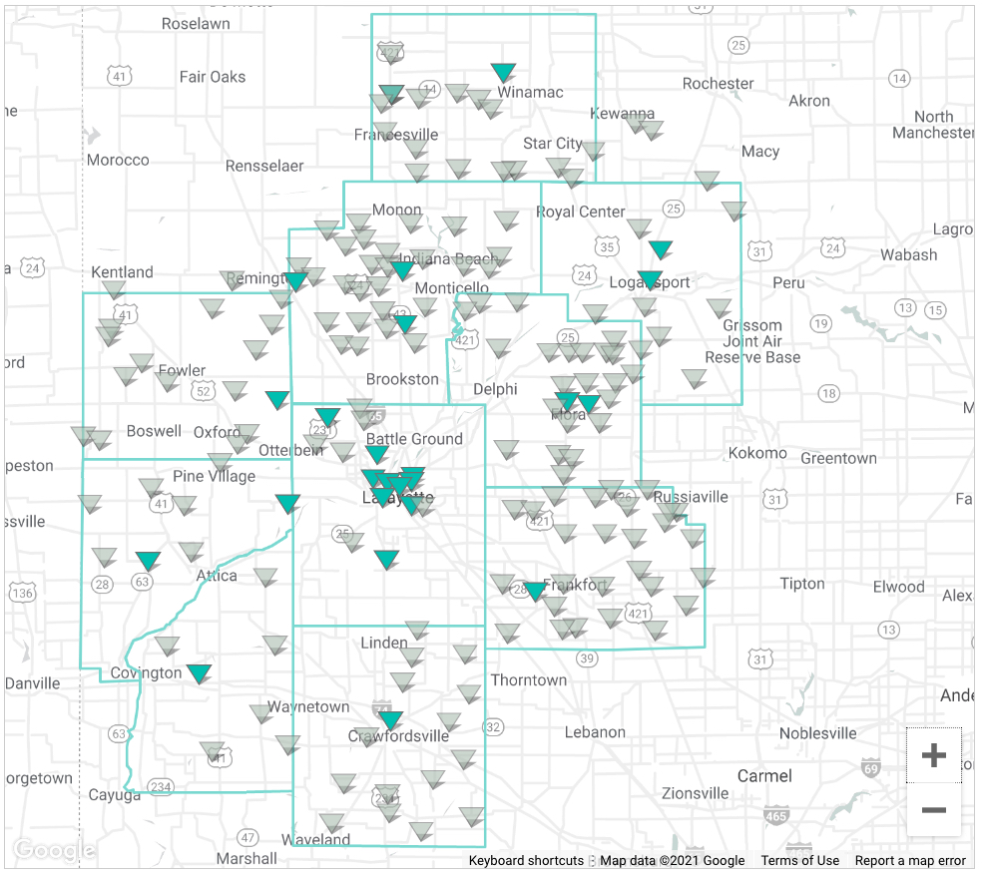
What’s for Student’s
Lesson purpose: Fill the missing temperature data in WHIN weather dataset using two interpolation algorithms
Wabash Heartland Innovation Network (WHIN) Weather Data Network (WDT)
Ten counties in North-Central Indiana
Pictures
Podcast
Video
Image Source: Google Cloud Platform
https://whin.org/weather/

Slide 8
Python script organization
Four major sections
Section 0- Setup
Section 1- Data Wrangling
Section 2- Data Analysis- Interpolation
Section 3- Data Visualization
Music
Podcast
Video
Image Source: Google Cloud Platform

Slide 9
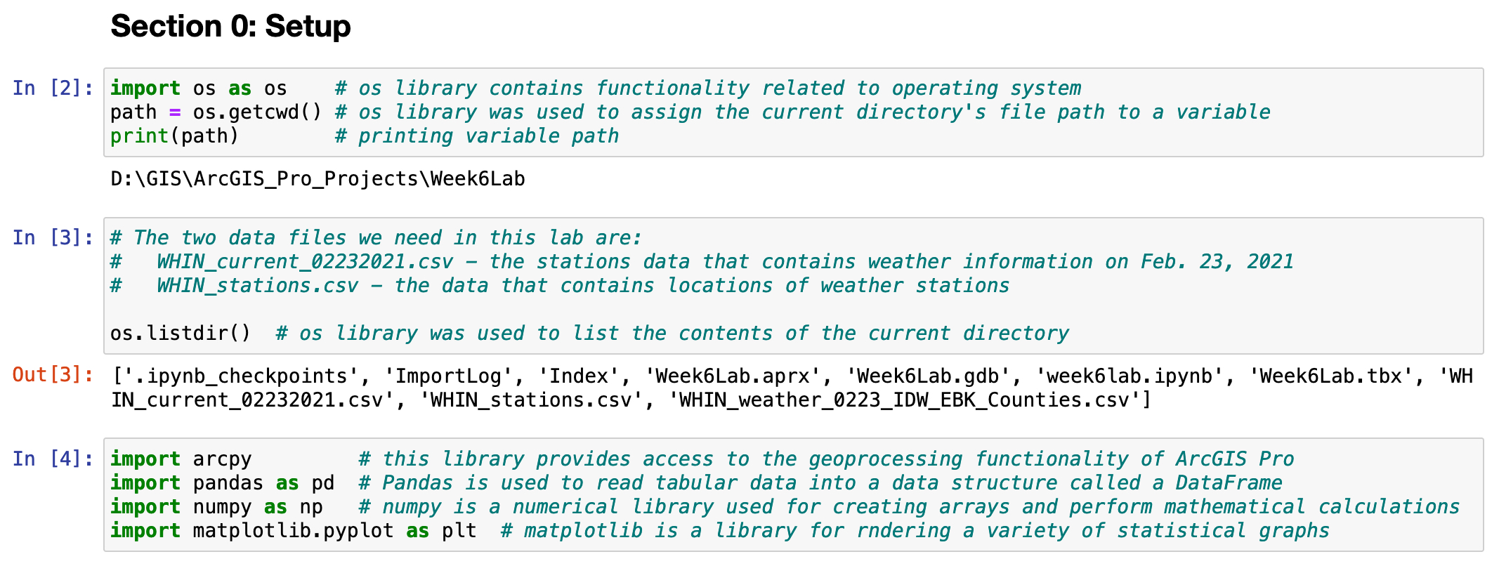
Section 0- Setup
Import required libraries
Establish connection with data files
Pictures
Music
Podcast
Video
Image Source: Google Cloud Platform

Slide 10
Section 1- Data Wrangling
In this section, you will clean weather data tables for interpolation analysis. Topics covered include:
Creating Pandas DataFrames using the two CSV datasets
Exploring the datasets using methods available to DataFrames for identifying a unique common key between the two datasets
Performing a merge operation to combine the datasets into a single DataFrame
Finding and correcting missing data where appropriate
Pictures
Music
Podcast
Video

Slide 11
Section 1- Data Wrangling-cont.
Creating Pandas DataFrames using the two CSV datasets
Coding steps to accomplish the above included the following:
. Read tabular weather station data from the two CSV files into separate DataFrames: pandas’s read_csv method.
. Use DataFrame’s head method to explore the first five rows of data in both the csv files.
. Use DataFrame’s shape method to reveal content in both the two csv files
WHIN_current_02232021: 136 rows and 26 columns of data.
WHIN_stations:167 rows and 4 columns of data.
Pictures
Music
Podcast
Video

Slide 12
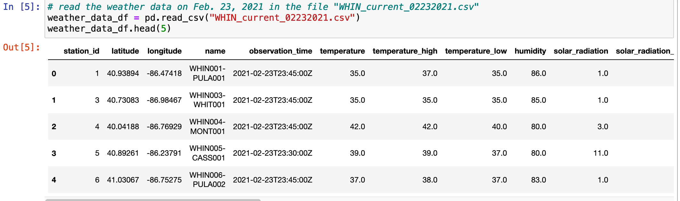
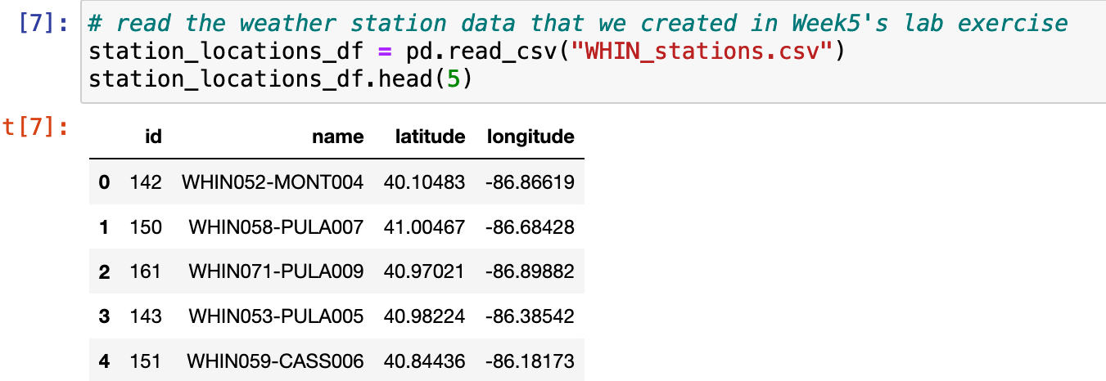
Section 1- Data Wrangling-cont.
Creating Pandas DataFrames using the two CSV datasets
Pictures
Music
Podcast
Video

Slide 13
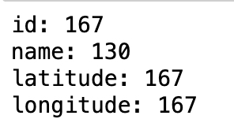
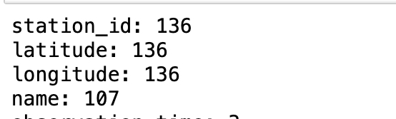
Section 1- Data Wrangling-cont.
Exploring the datasets using methods available to DataFrames
Determine any unique common keys before merging the two datasets into a single DataFrame. Coding steps to accomplish the above included the following:
. Use .column method to learn about columns present in the DataFrame.
. Determine unique values in each field and column by using .unique method
. Remove duplicates.
. Rename unique columns
Pictures
Music
Podcast
Video

Slide 14
Section 1- Data Wrangling-cont.
Performing a merge operation to combine the datasets into a single DataFrame
Merging two tables help to find out which stations have missing weather data. Coding steps to accomplish the above included the following:
. Check if common key has same name in both the DataFrames
. Use DataFrame’s .merge method to combine both the DataFrames.
. Use DataFrame’s head method to explore the first five rows of data in the merged table
. Use DataFrame’s shape method to reveal content in the merged table
Pictures
Music
Video
# why are there 168 rows now when largest DataFrame had 167?
# there was a station that did not match between the two tables

Slide 15
Section 1- Data Wrangling-cont.
Finding and correcting missing data where appropriate
The main interest will be focused on the latitude and longitude values for later operation and the temperature values.
Coding steps to accomplish the above included the following:
Pictures
Music
. You will create a point feature class (vector) by using the latitude and longitude values so it is important that they are present. isnull () method
. It will be useful to know how many of the temperature values are missing in the current dataset as those will be used during interpolation. isnull () method
. Save the merged table as a csv file
Video

Slide 16
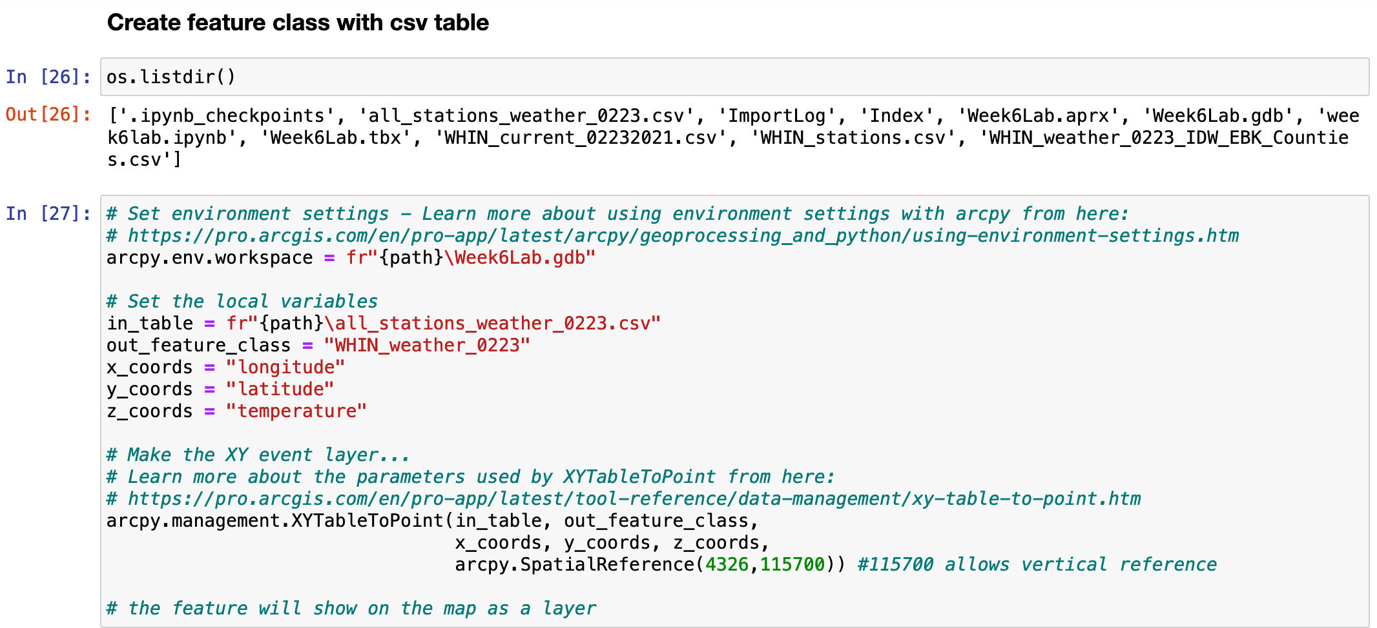
Section 2- Data Analysis (Interpolation)
Topics covered include:
List directory .listdir()
Set ArcPy environment settings
Create point feature class of “all_stations_weather_0223” table
Pictures
Music
Video

Slide 17
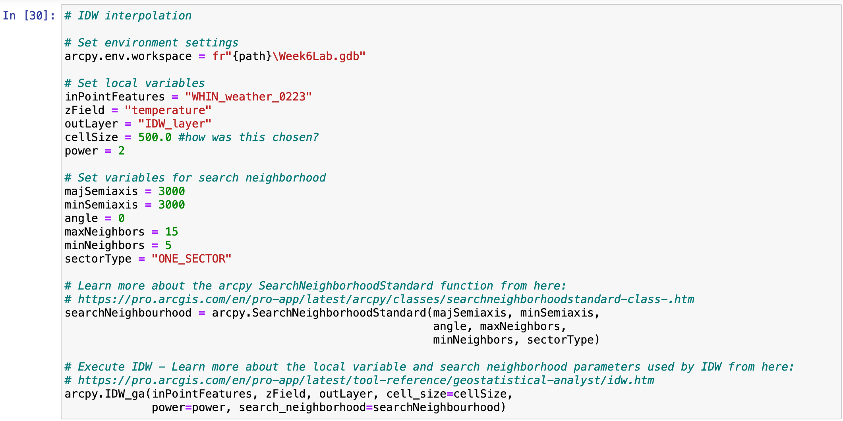
Section 2- Data Analysis (Interpolation)-contd.
Perform Inverse Distance Weighted (IDW) Interpolation- declare multiple parameters
Pictures
Music
Video

Slide 18
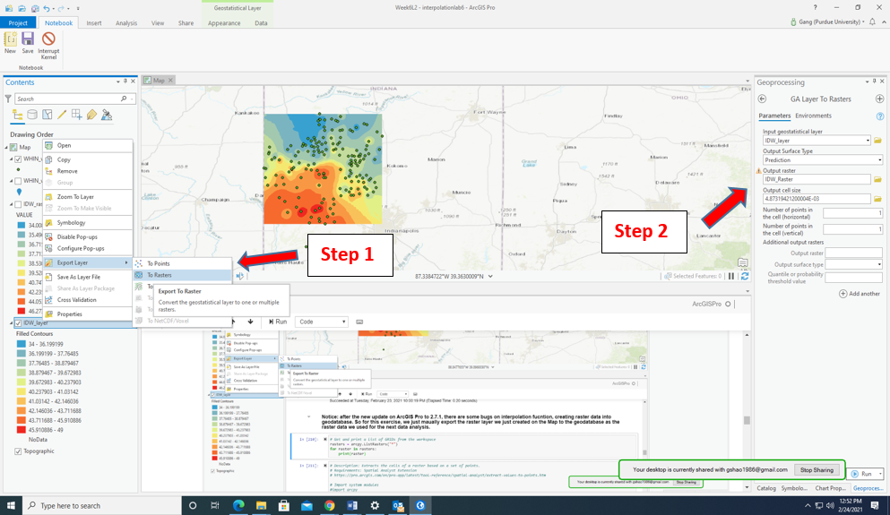
Section 2- Data Analysis (Interpolation)-contd.
Results
Pictures
Music
Video

Slide 19
Section 2- Data Analysis (Interpolation)-contd.
Extract temperature values for each station
Any remaining Data cleaning is performed
Pictures
Music
Video

Slide 20
Assessment 1
Perform Empirical Bayesian Kriging (EBK) interpolation on your own based on the demo above and add the results as "Temp_Kriging" to the resulted feature class. The final feature class will include both "Temp_IDW" and "Temp_Kriging".
Use the following link as a reference to write the script. Name: EmpiricalBayesianKriging_Example_02.py
https://pro.arcgis.com/en/pro-app/latest/tool-reference/geostatistical-analyst/empirical-bayesian-kriging.htm
Pictures
Music
Video

Slide 21
Section 3- Data Visualization
Topics covered include:
. Using Pandas to read a CSV file named WHIN_weather_0223_IDW_EBK_Counties into a DataFrame.
. Students import the Seaborn and Matplotlib Python libraries. Seaborn is a data visualization library built off Matplotlib and it can integrate with Matplotlib’s plotting surface.
. Students were provided with a set of instructions for installing Seaborn library in Python environment (Python_Env_Setup_for_seaborn.docx).
. Histogram, scatterplots, and boxplots creation
Pictures
Music
Video

Slide 22
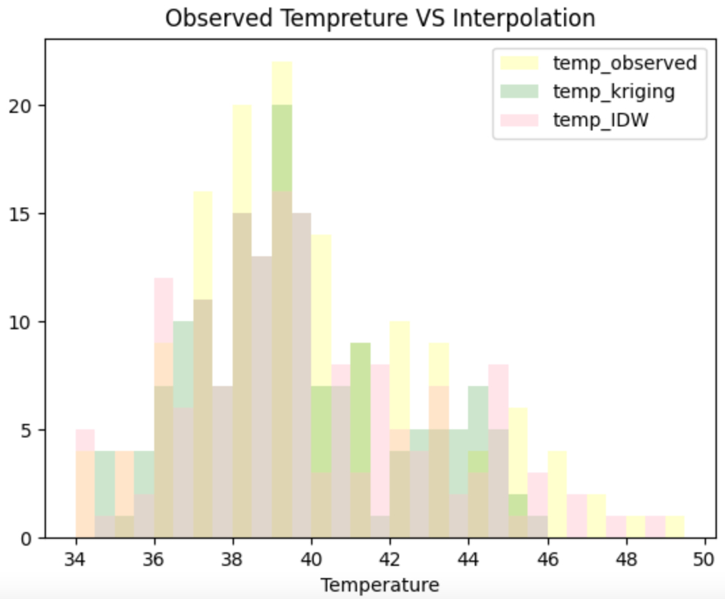
Section 3- Data Visualization-contd.
Results- Histogram
Pictures
Music
Video

Slide 23
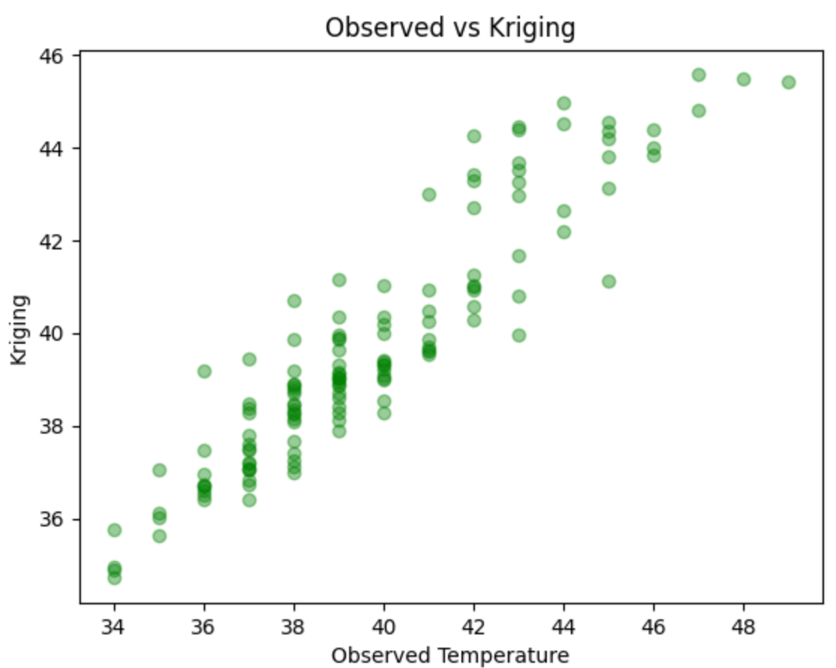
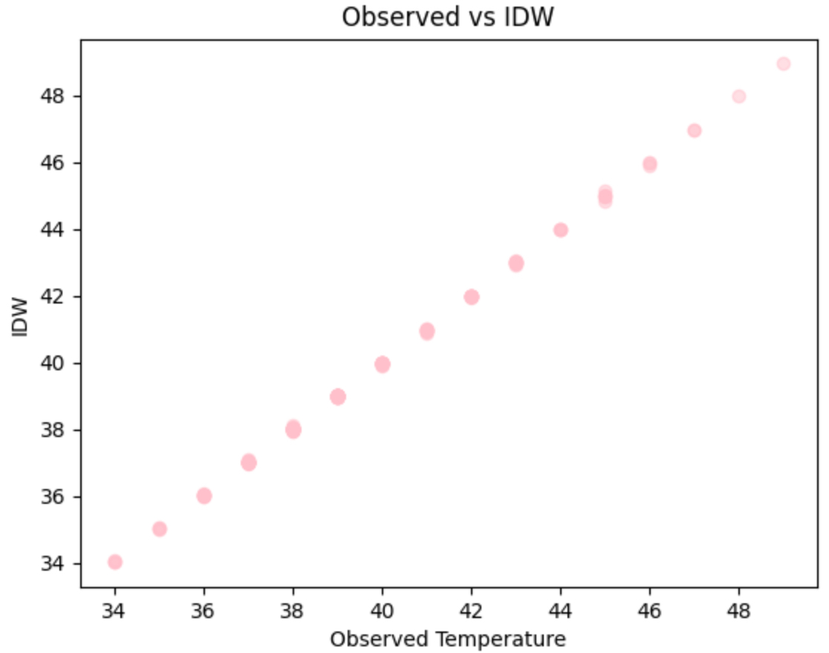
Section 3- Data Visualization-contd.
Results- Scatterplot
Pictures
Music
Video

Slide 24
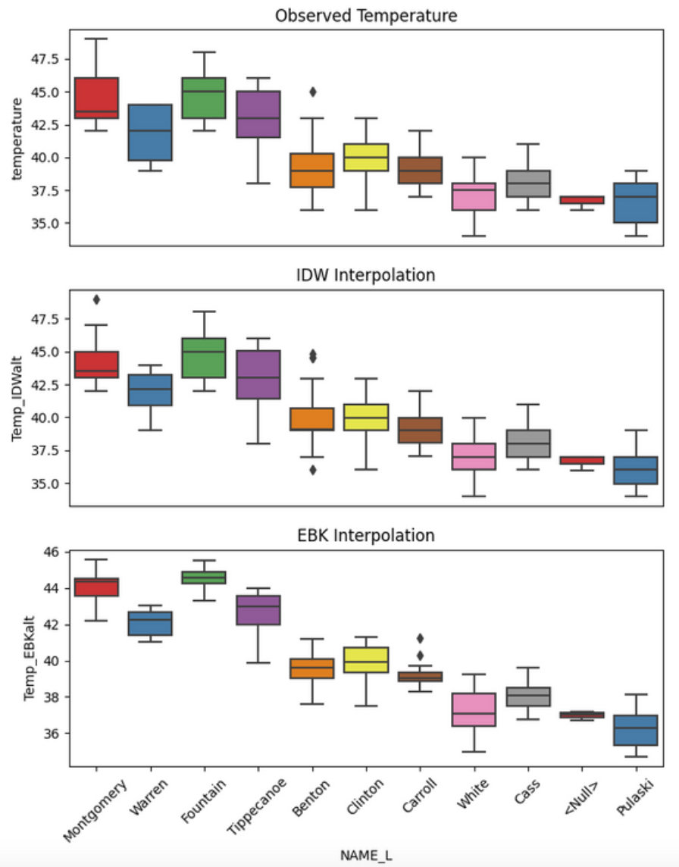
Section 3- Data Visualization-contd.
Results- Boxplots
Pictures
Music
coolest county (Pulaski) and the hottest county (Fountain))
Video

Slide 25
Summary
The lesson demonstrates as to how students with a few lines of code could be engaged in solving real-world problems by invoking data analysis libraries.
Instructors interested in implementing this lesson may consider localizing it by obtaining local weather data or adapt the same approach for analyzing long-term air or water quality data.
The case study exemplifies as to how use of Jupyter notebook within ArcGIS Pro’s project could be used for imparting training on data wrangling and data analysis to agriscience students.
Pictures
Music
Video

Slide 26
Acknowledgments
This work is supported by the USDA-NIFA Project# 17000716. Weather data provided by WHIN is gratefully acknowledged.
The authors would also like to thank Mr. Ben Hancock, Staff Programmer, Agricultural and Biological Engineering (ABE) at Purdue for his help with Python instruction material, and
Dr. Dennis Buckmaster for inviting to participate in a special 2021 ASABE session on “Instructional Case Studies with Data Sets for YOUR Instruction”.
Pictures
Music
Video

Slide 27

RELATED OPPORTUNITY
Pictures
Music
MS DEGREE IN DATA SCIENCE AND ENGINEERING CONCENTRATION (ABE)
Funded by USDA NIFA Award# 2021-38420-34063
https://dad.saraswat.rcac.purdue.edu/index.php/nnf-program/
Podcast
Video
One position still open for Fall 2021, please apply
Two opening each in Fall 2022 and 2023, respectively
Image Source: Google Cloud Platform

Slide 28
Thank you
Your feedback is welcome
I will appreciate any guest lecture opportunity to extend this lesson further into the course(s) that you teach

